Slide 1
ADDITION
TOOL TALKS

Slide 2
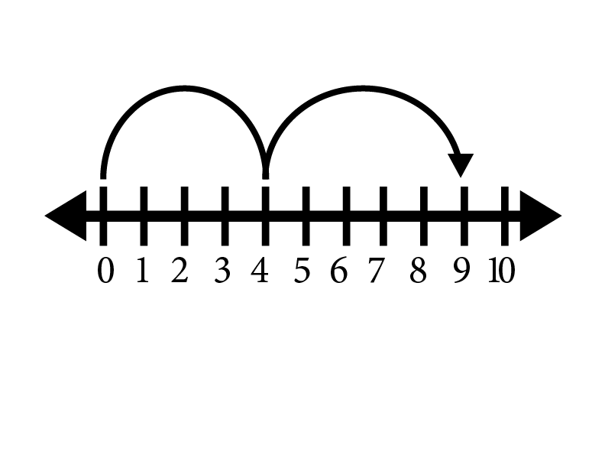
HERE’S THE MODEL. WHAT’S THE STORY?

Slide 3
4 + 5 = 9

Slide 4
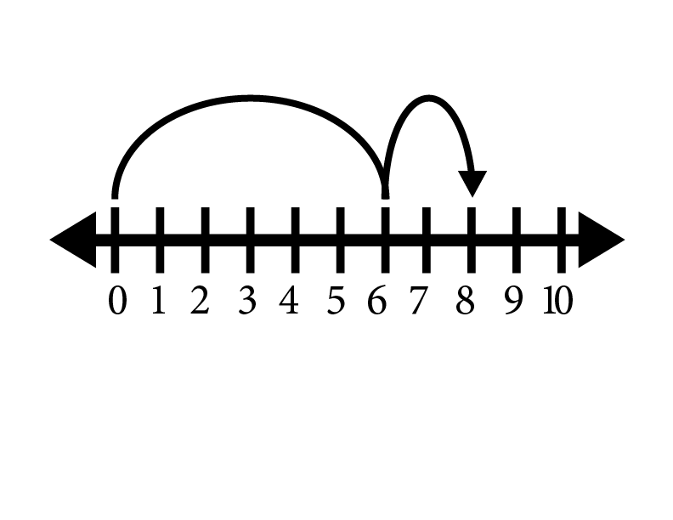
HERE’S THE MODEL. WHAT’S THE STORY?

Slide 5
6 + 2 = 8

Slide 6
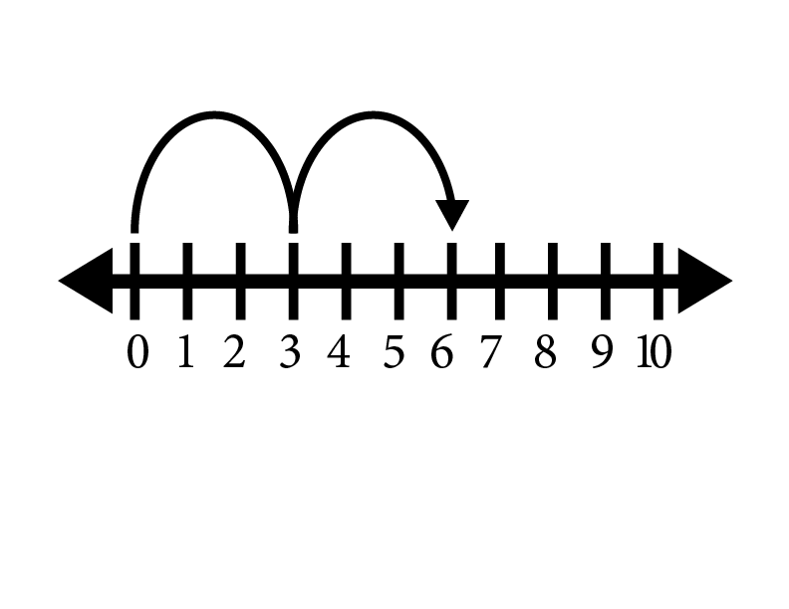
HERE’S THE MODEL. WHAT’S THE STORY?

Slide 7
3 + 3 = 6

Slide 8
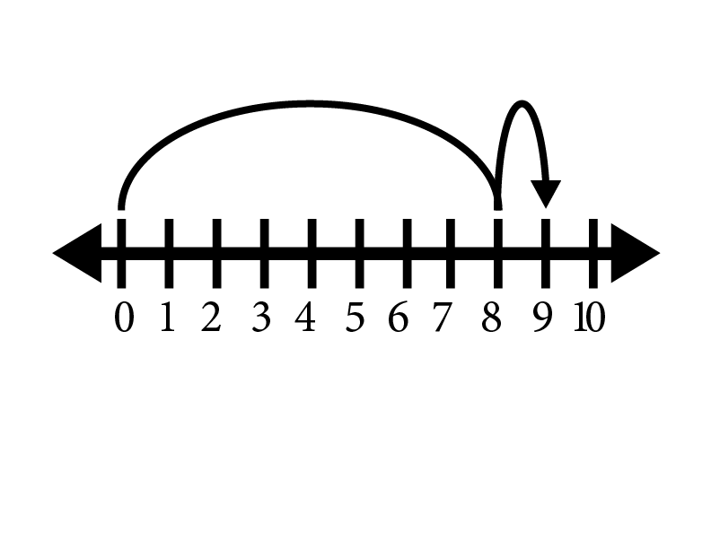
HERE’S THE MODEL. WHAT’S THE STORY?

Slide 9
8 + 1 = 9

Slide 10
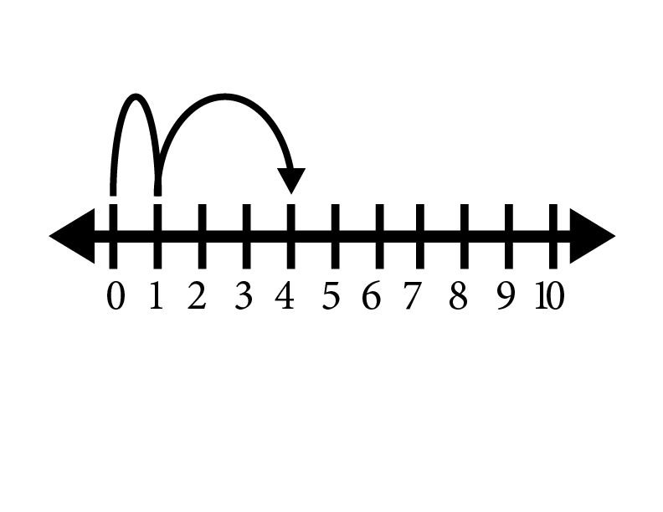
HERE’S THE PROBLEM. WHAT’S THE STORY?

Slide 11
1 + 3 = 4

Slide 12
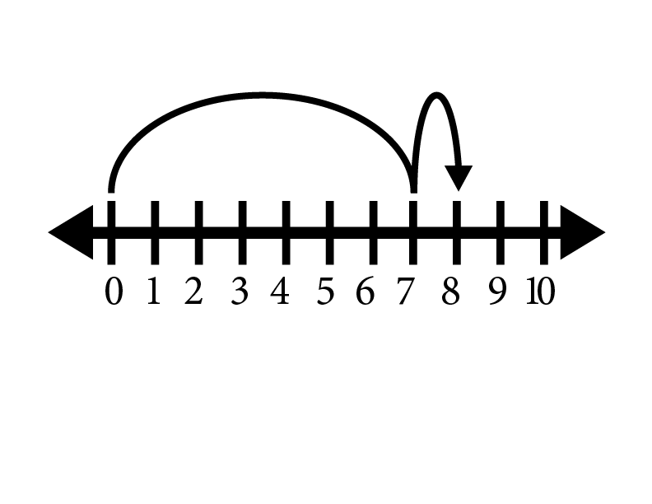
HERE’S THE MODEL. WHAT’S THE STORY?

Slide 13
7 + 1 = 8

Slide 14
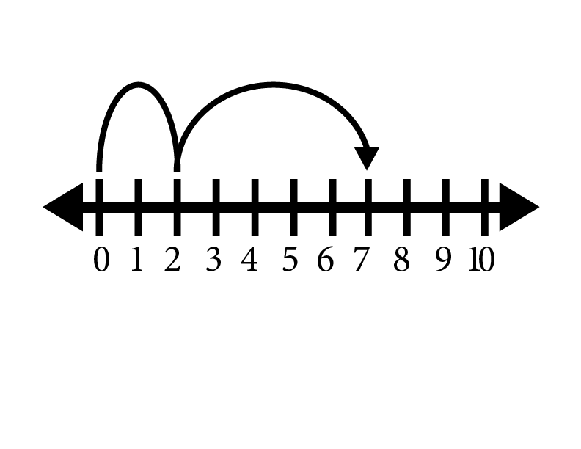
HERE’S THE MODEL. WHAT’S THE STORY?

Slide 15
2 + 5 = 7

Slide 16
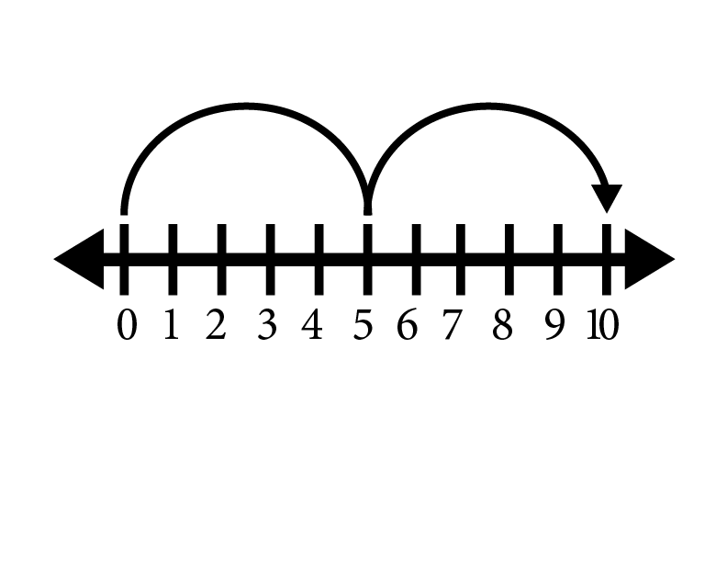
HERE’S THE MODEL. WHAT’S THE STORY?

Slide 17
5 + 5 = 10

Slide 18
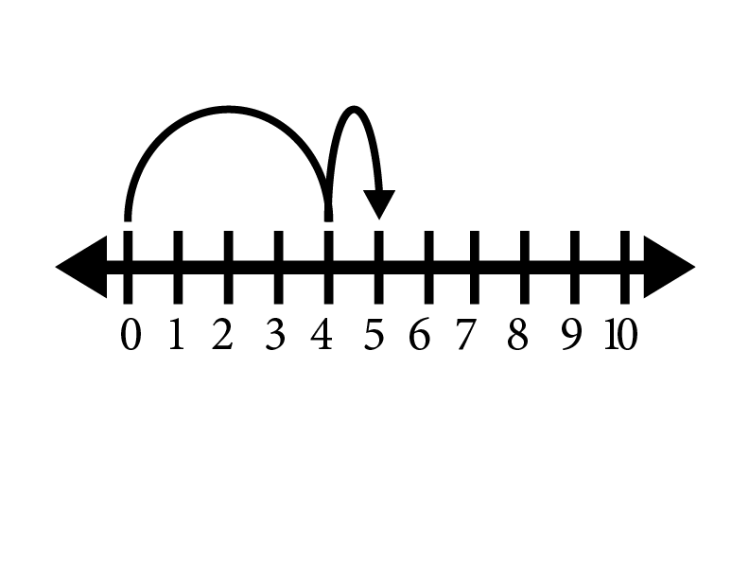
HERE’S THE MODEL. WHAT’S THE STORY?

Slide 19
4 + 1 = 5

