Slide 1
SUBTRACTION
TOOL TALKS

Slide 2
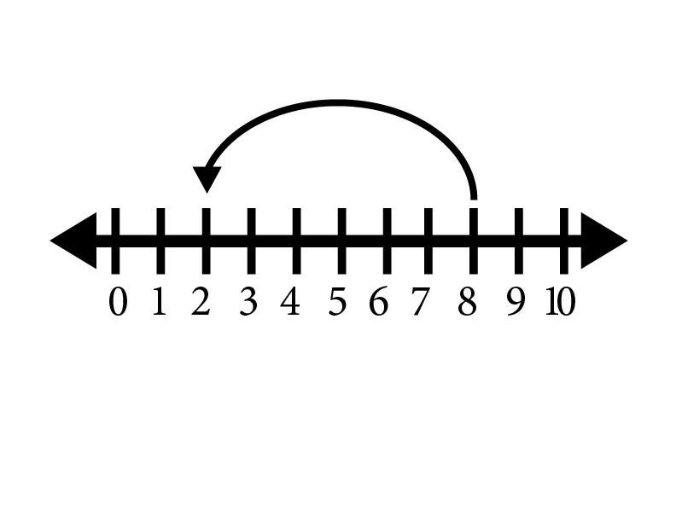
HERE’S THE MODEL. WHAT’S THE STORY?

Slide 3
8 - 6 = 2

Slide 4
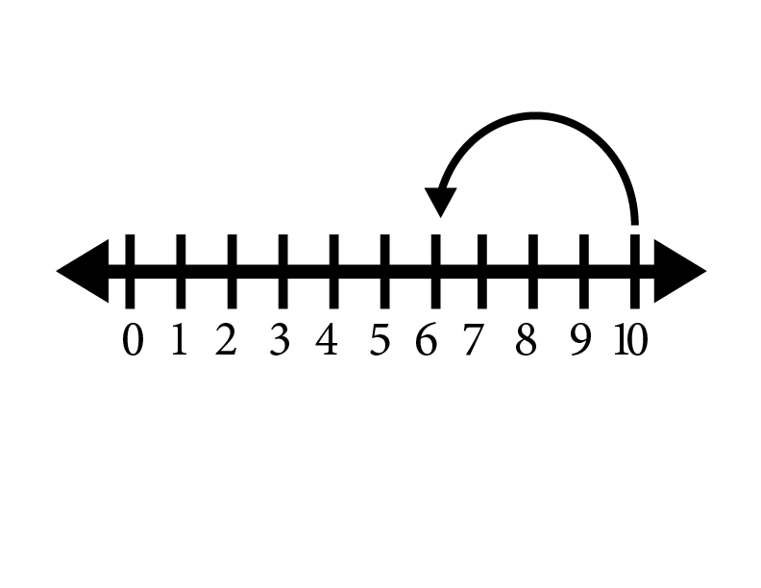
HERE’S THE MODEL. WHAT’S THE STORY?

Slide 5
10 - 4 = 6

Slide 6
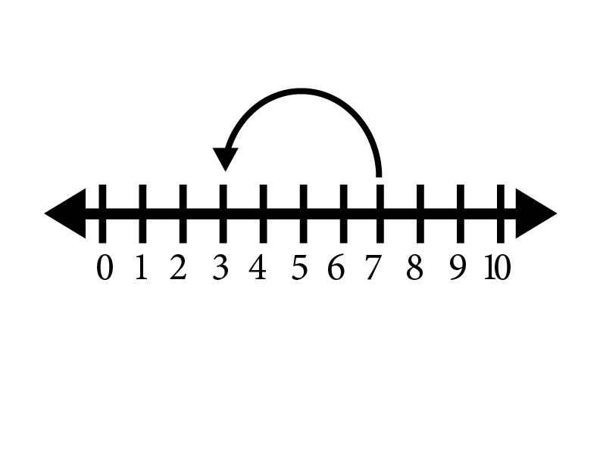
HERE’S THE MODEL. WHAT’S THE STORY?

Slide 7
7 - 4 = 3

Slide 8
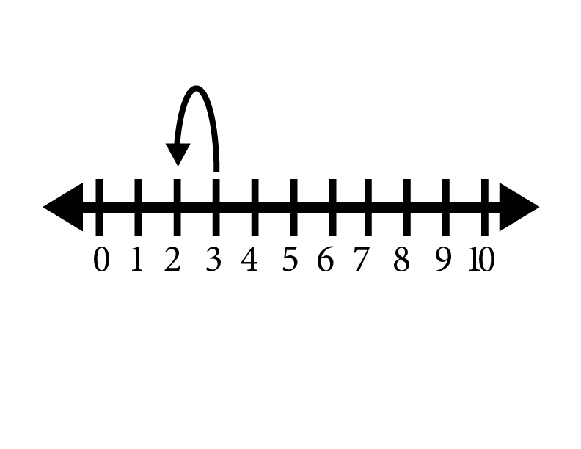
HERE’S THE MODEL. WHAT’S THE STORY?

Slide 9
3 - 1 = 2

Slide 10
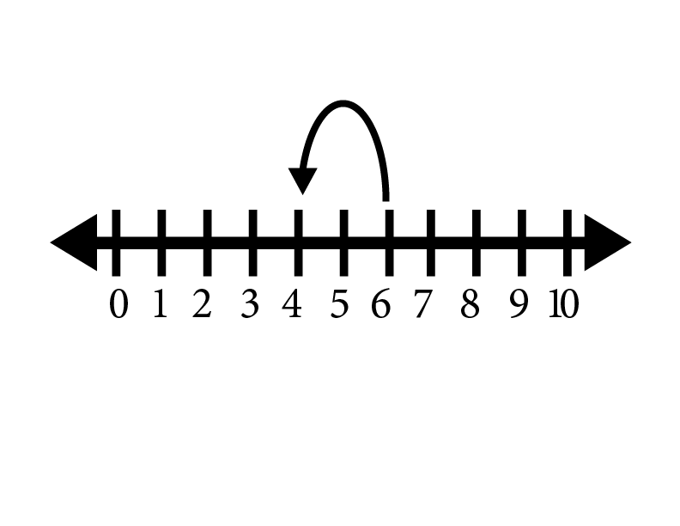
HERE’S THE MODEL. WHAT’S THE STORY?

Slide 11
6 - 2 = 4

Slide 12
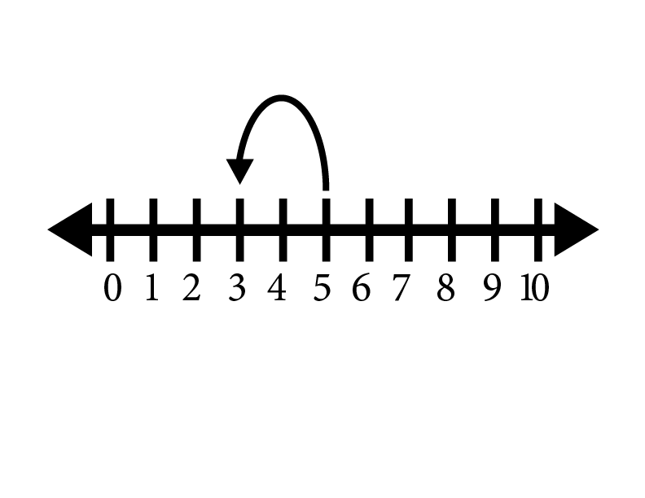
HERE’S THE MODEL. WHAT’S THE STORY?

Slide 13
5 - 2 = 3

Slide 14
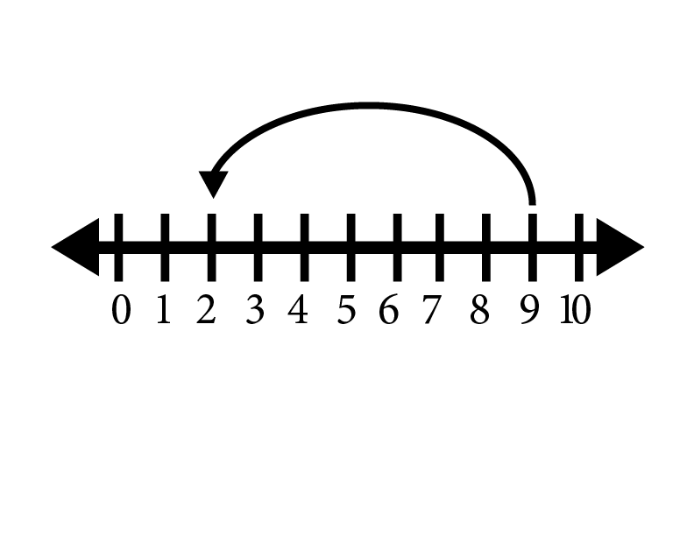
HERE’S THE MODEL. WHAT’S THE STORY?

Slide 15
9 - 7 = 2

Slide 16
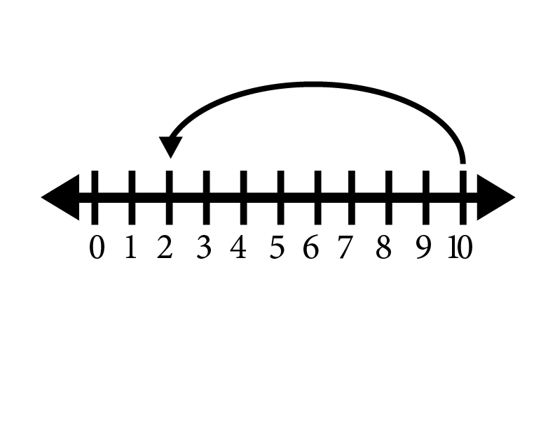
HERE’S THE MODEL. WHAT’S THE STORY?

Slide 17
10 - 8 = 2

Slide 18
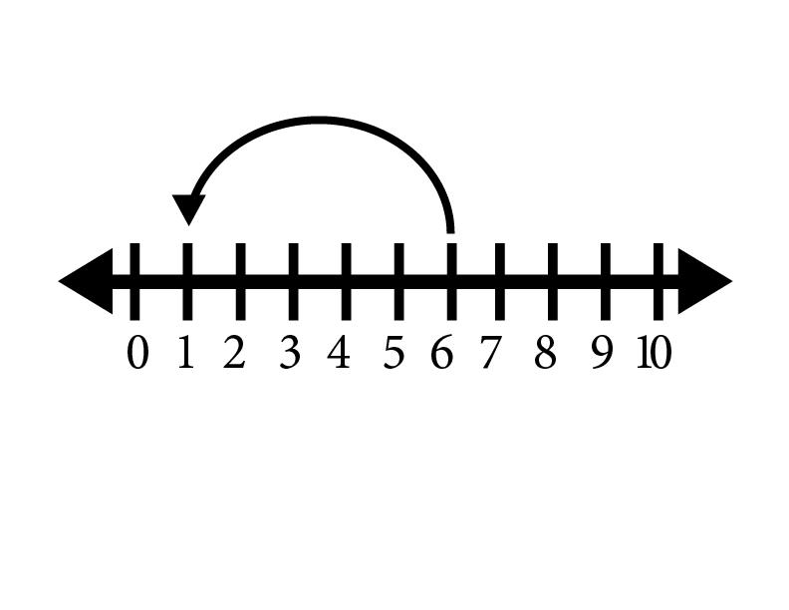
HERE’S THE MODEL. WHAT’S THE STORY?

Slide 19
6 - 5 = 1

Slide 20
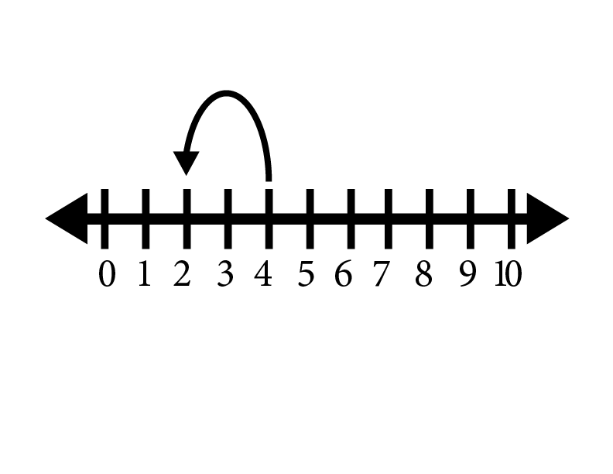
HERE’S THE MODEL. WHAT’S THE STORY?

Slide 21
4 - 2 = 2

