Slide 1
SUBTRACTION CHATS

Slide 2
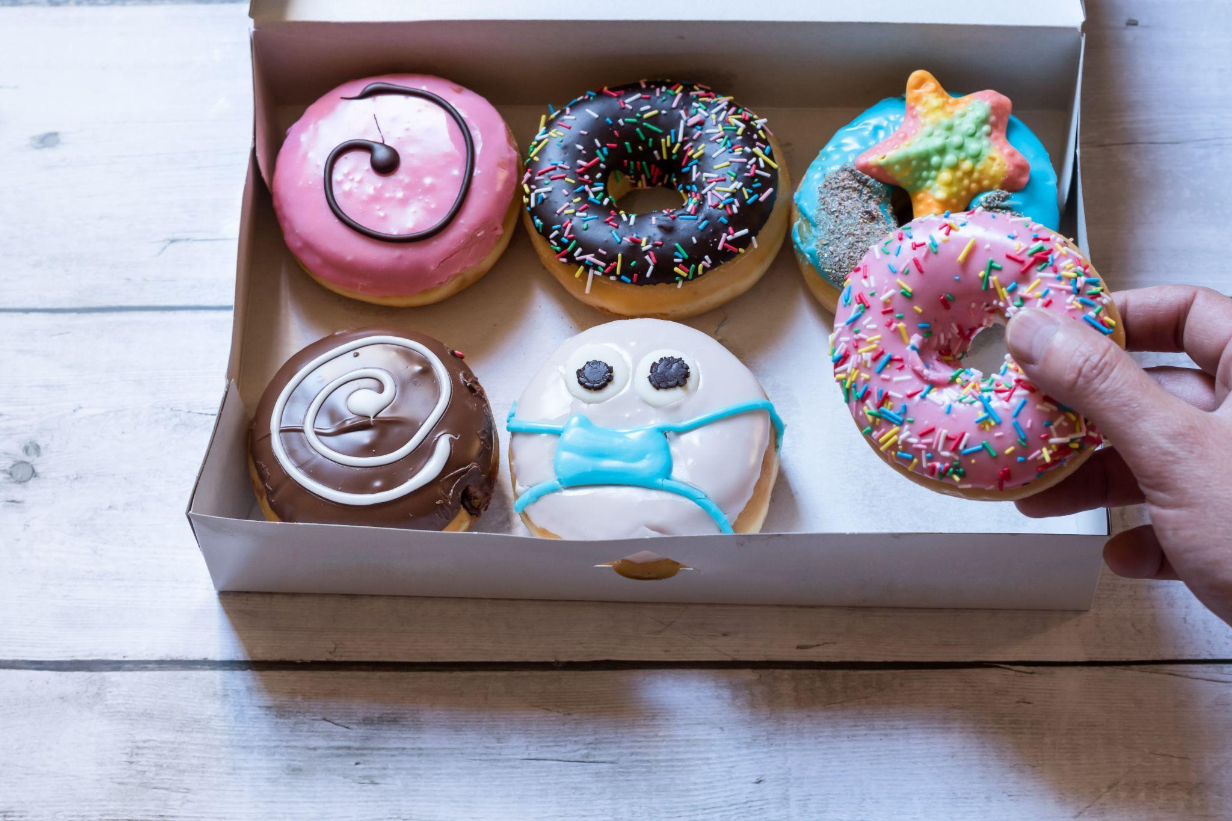
Here’s the model, what the story?

Slide 3
6 - 1 = 5

Slide 4
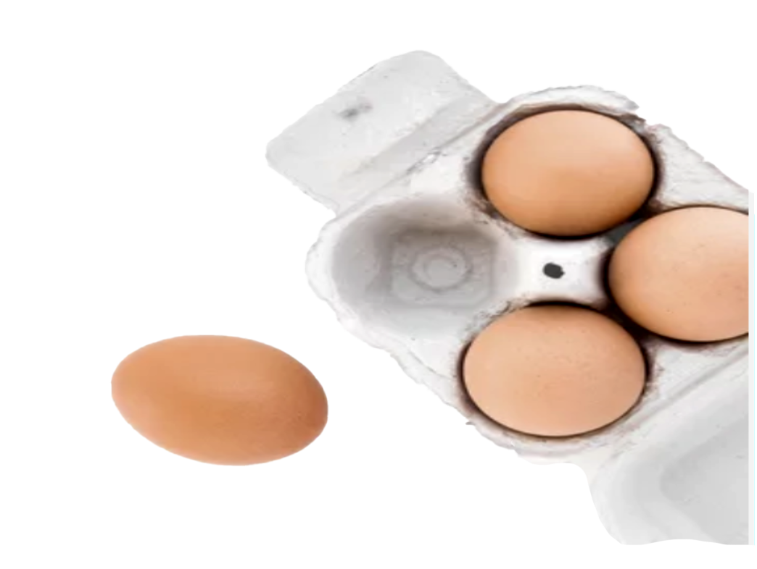
Here’s the model, what the story?

Slide 5
4 - 1 = 3

Slide 6
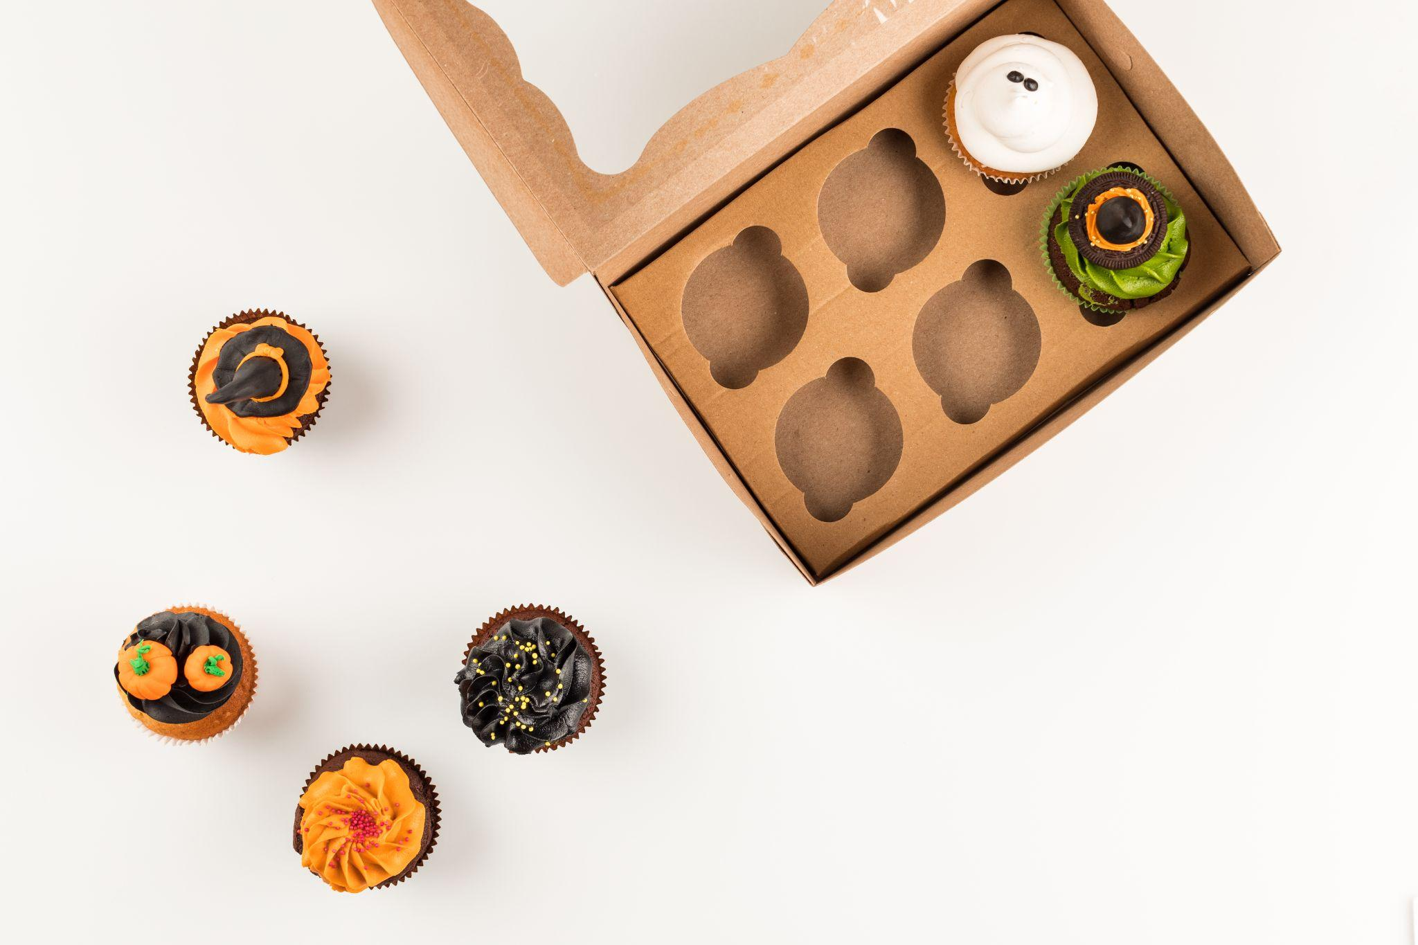
Here’s the model, what the story?

Slide 7
6 - 4 = 2

Slide 8
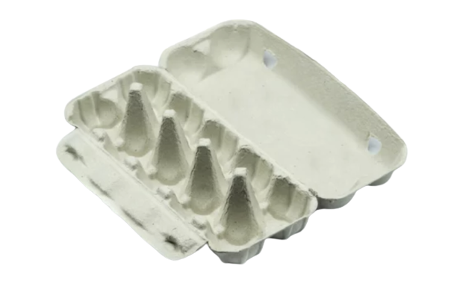
Here’s the model, what the story?

Slide 9
10 - 10 = 0

Slide 10

Here’s the model, what the story?

Slide 11
6 - 5 = 1

Slide 12

Here’s the model, what the story?

Slide 13
6 - 1 = 5

Slide 14
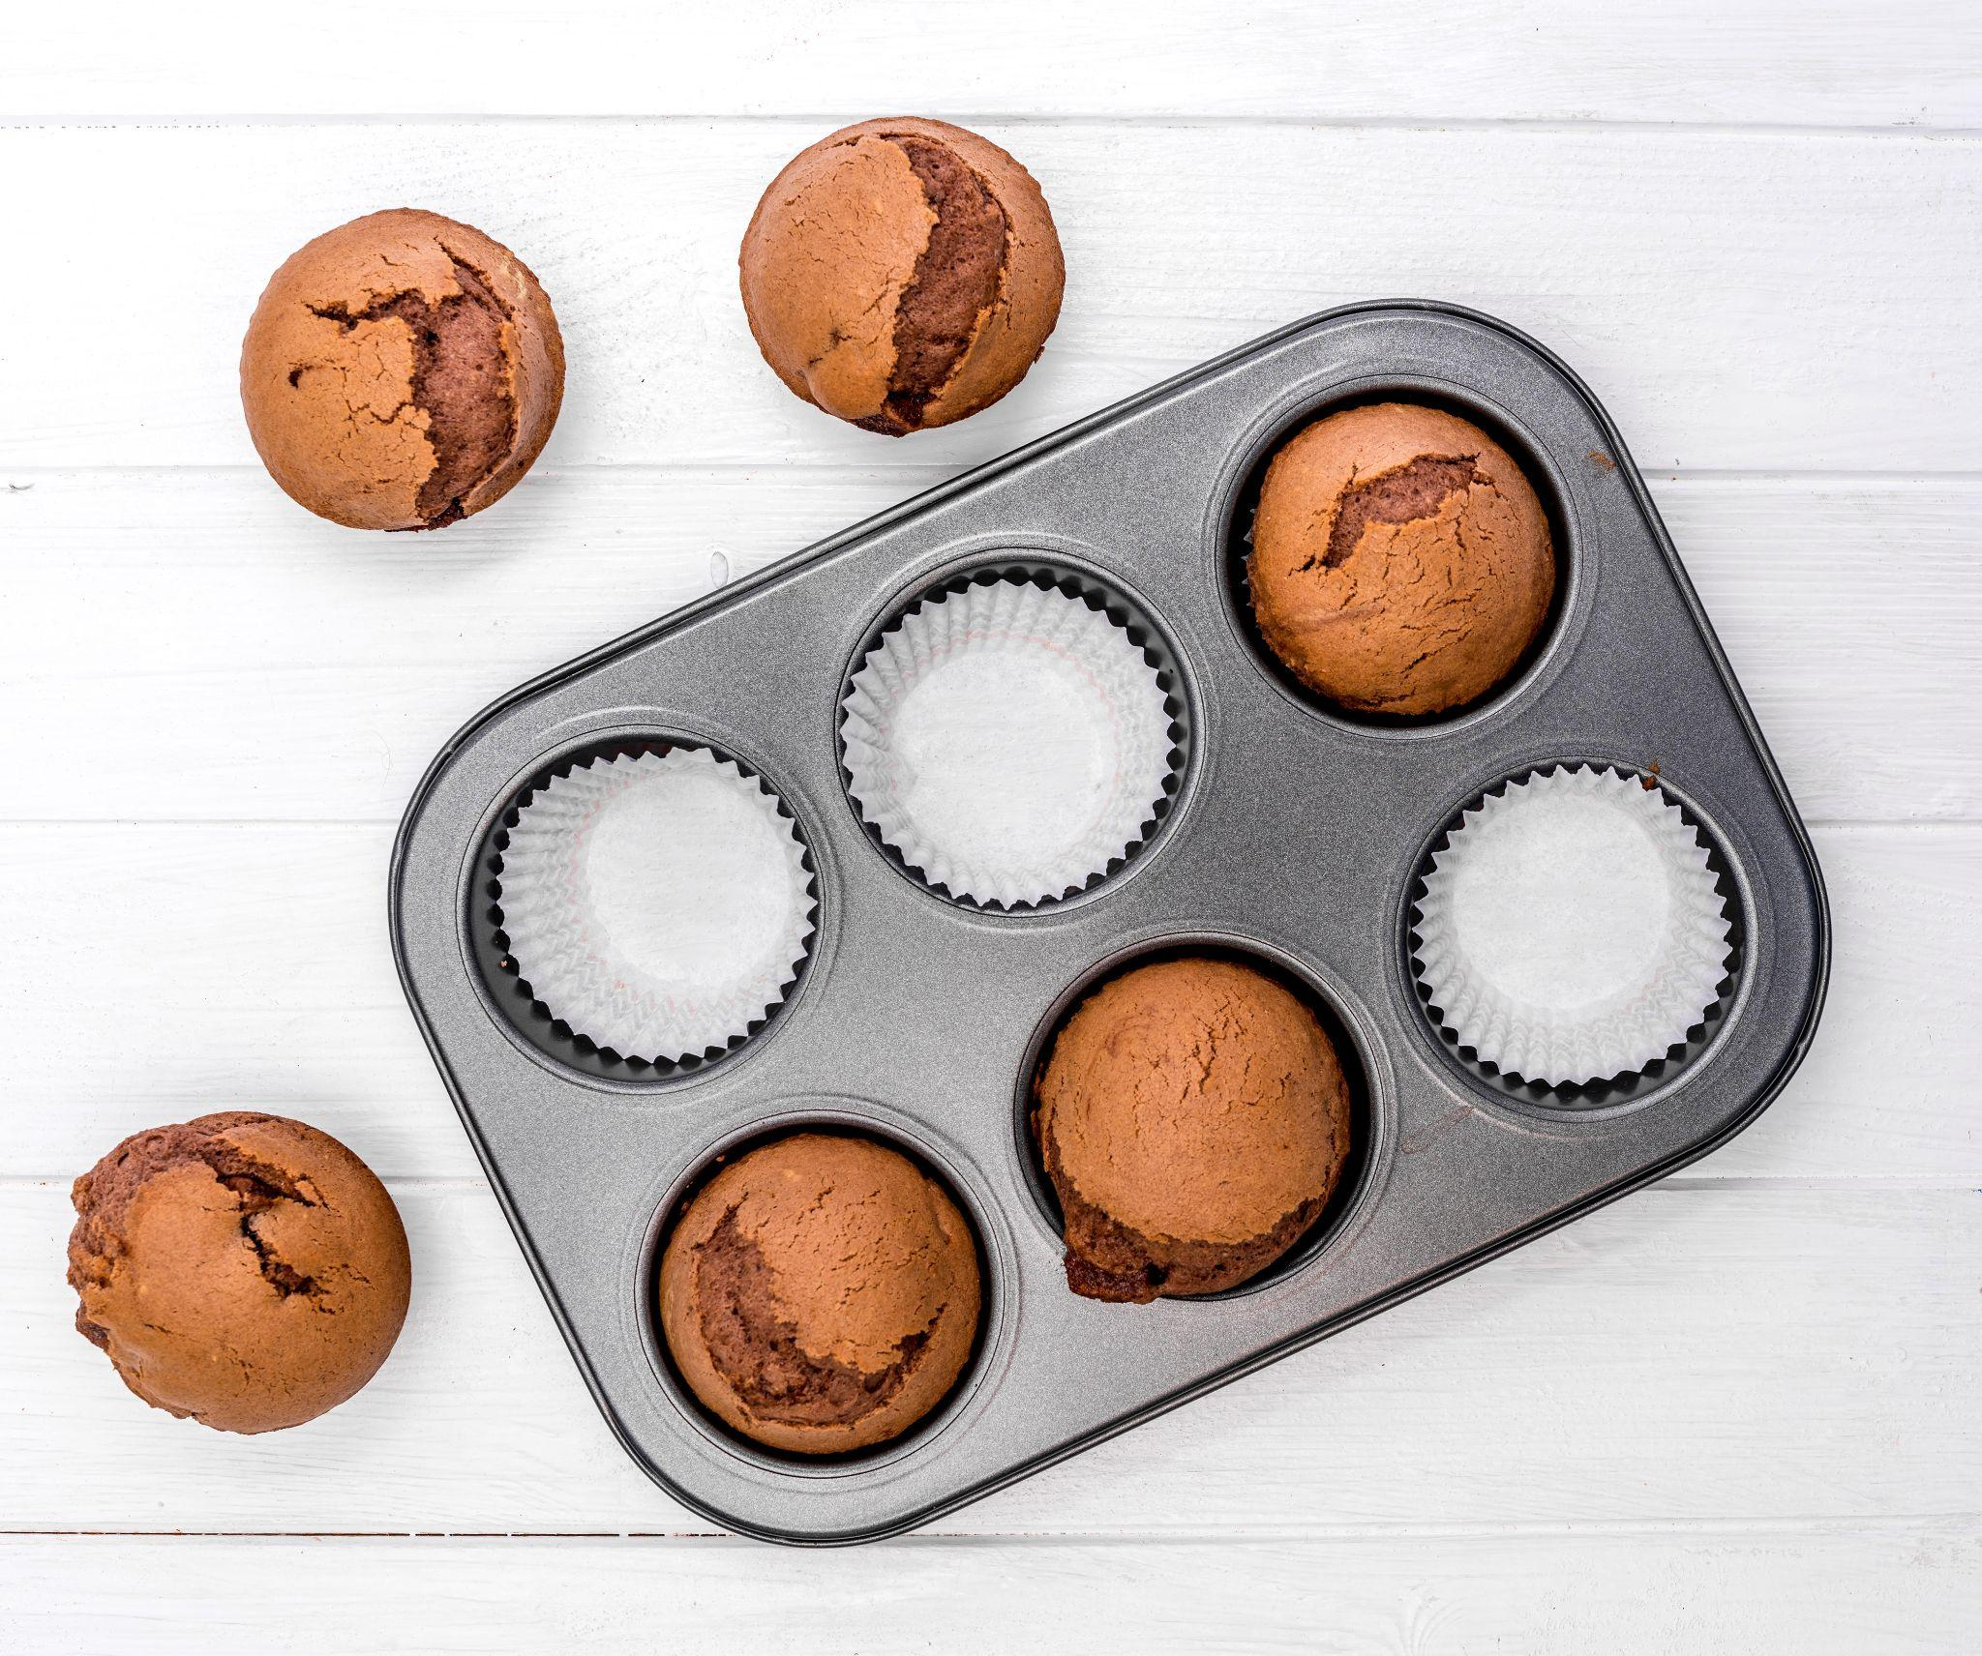
Here’s the model, what the story?

Slide 15
6 - 3 = 3

Slide 16
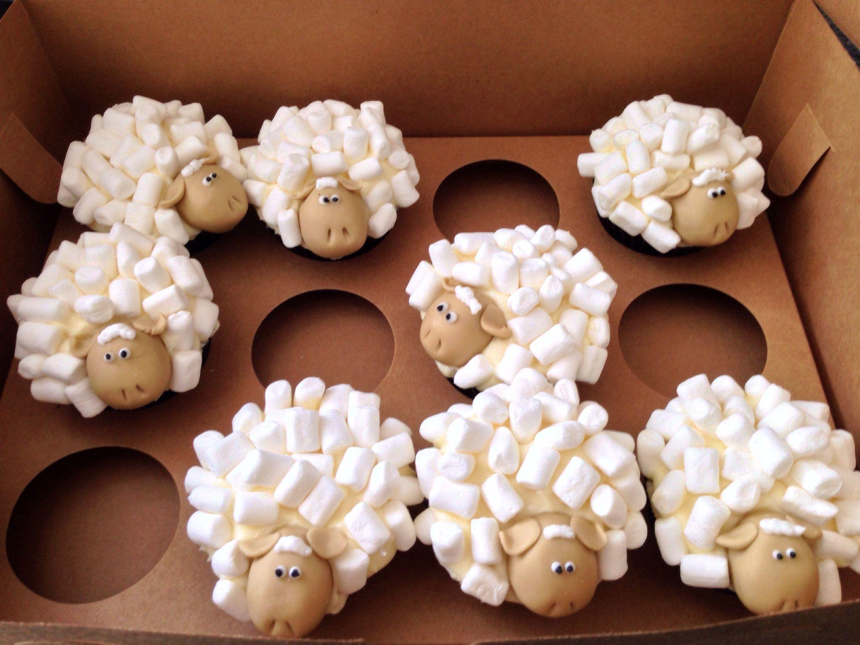
Here’s the model, what the story?

Slide 17
12 - 4 = 8

Slide 18
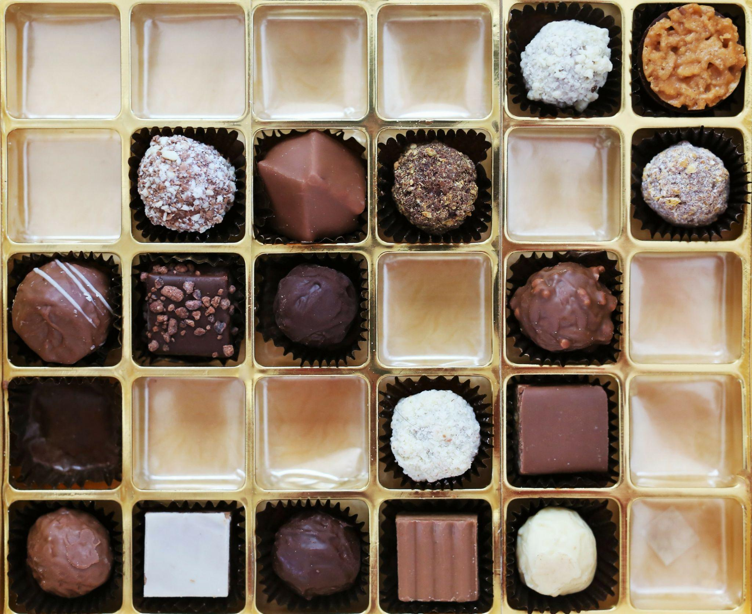
Here’s the model, what the story?

Slide 19
30 - 12 = 18

Slide 20
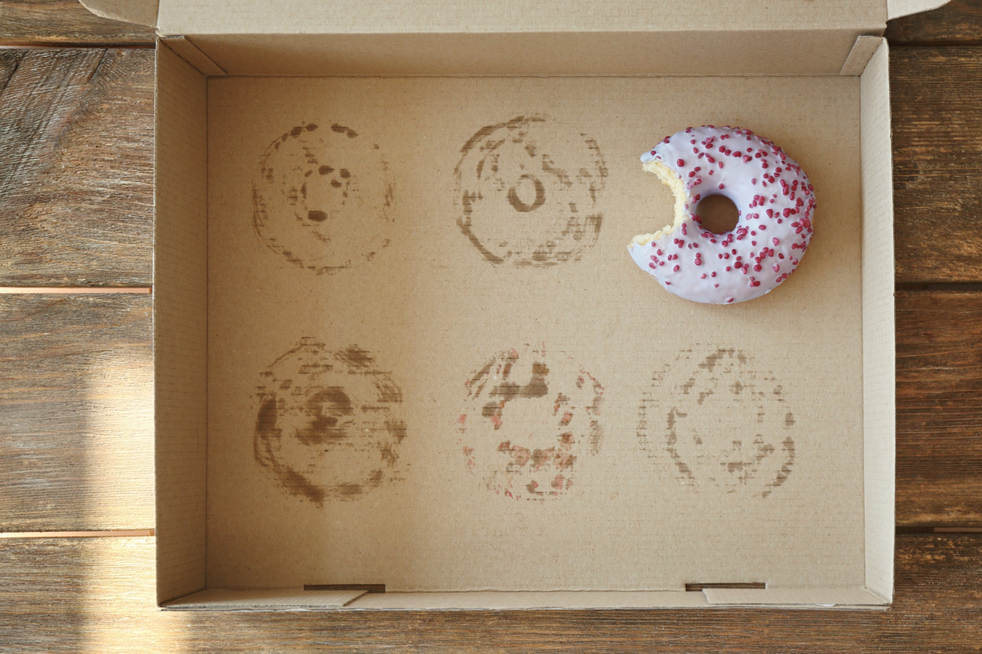
Here’s the model, what the story?

Slide 21
6 - 5 = 1

Slide 22
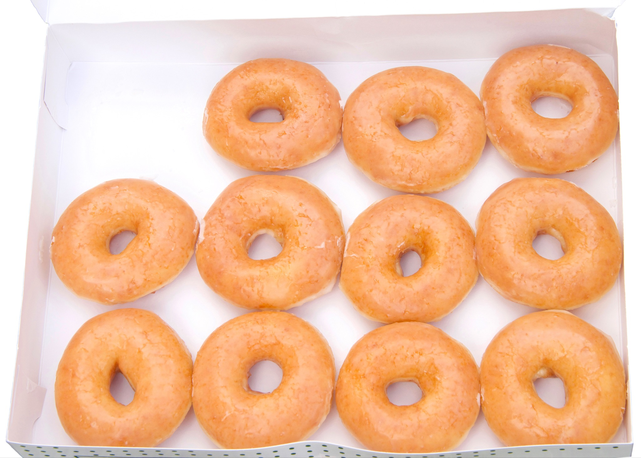
Here’s the model, what the story?

Slide 23
12 - 1 = 11

Slide 24

Here’s the model, what the story?

Slide 25
9 - 2 = 7

Slide 26
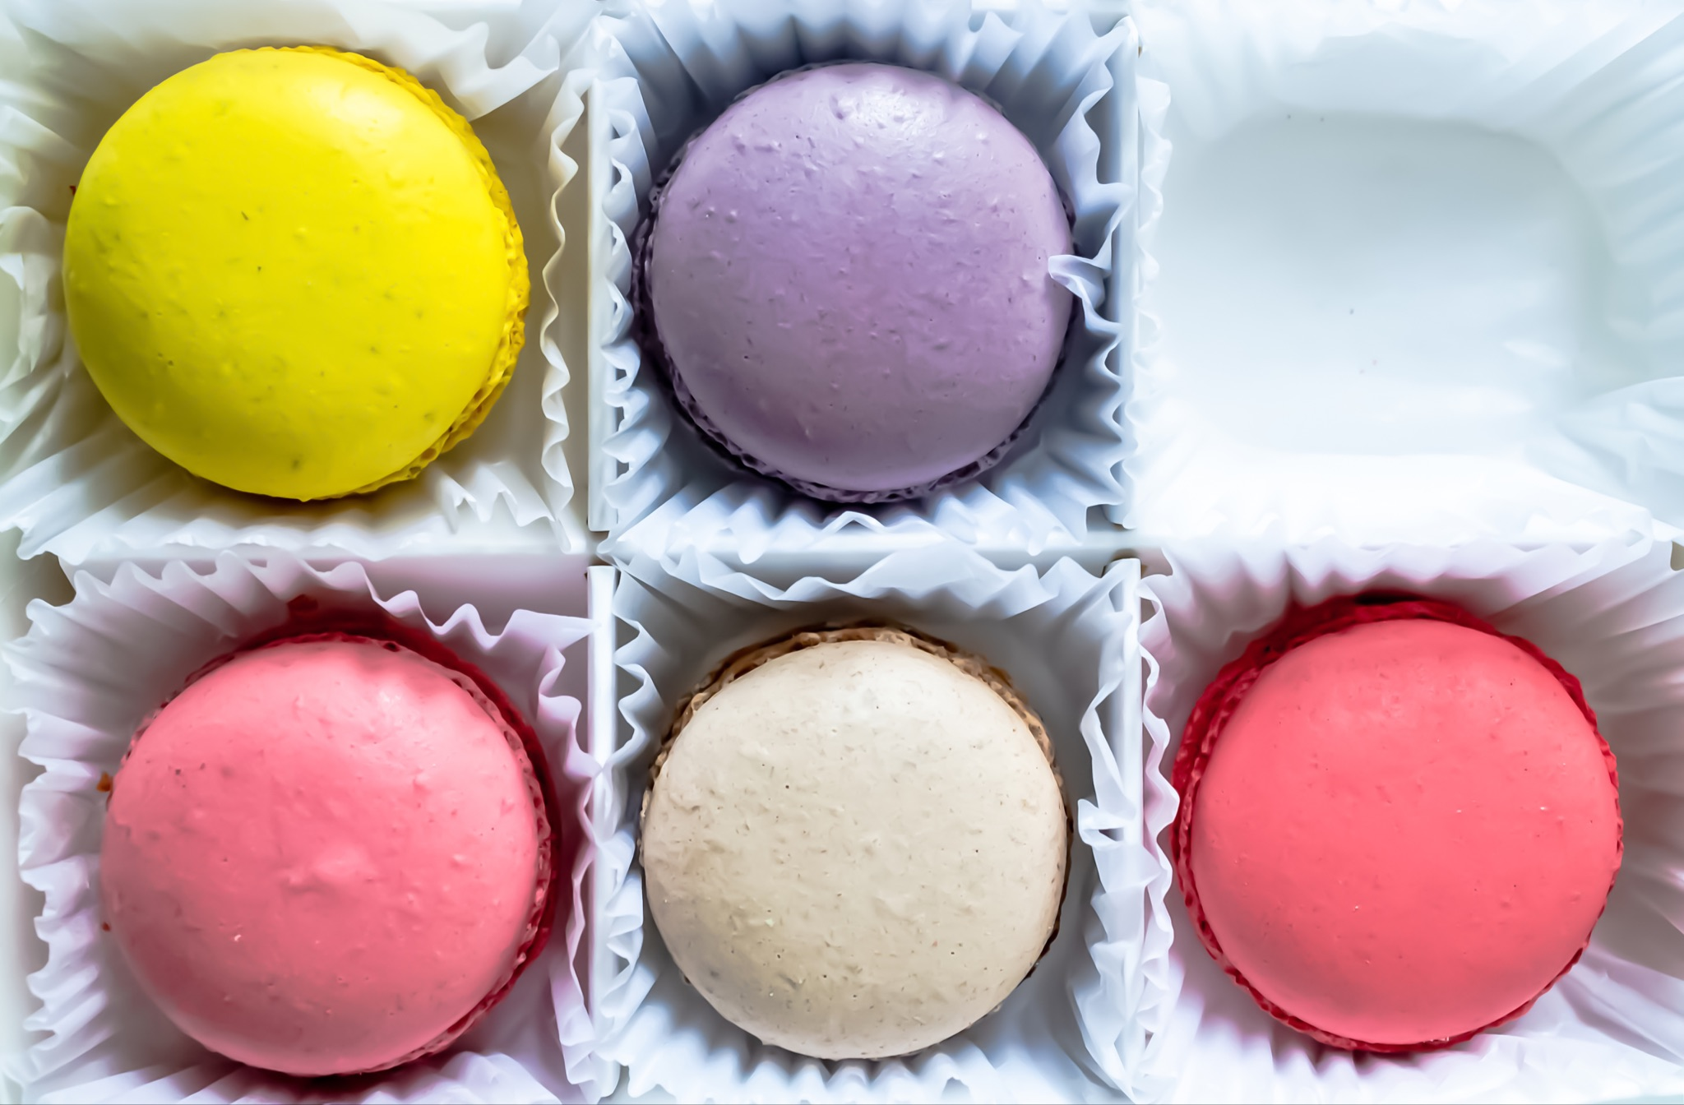
Here’s the model, what the story?

Slide 27
6 - 1 = 5

Slide 28
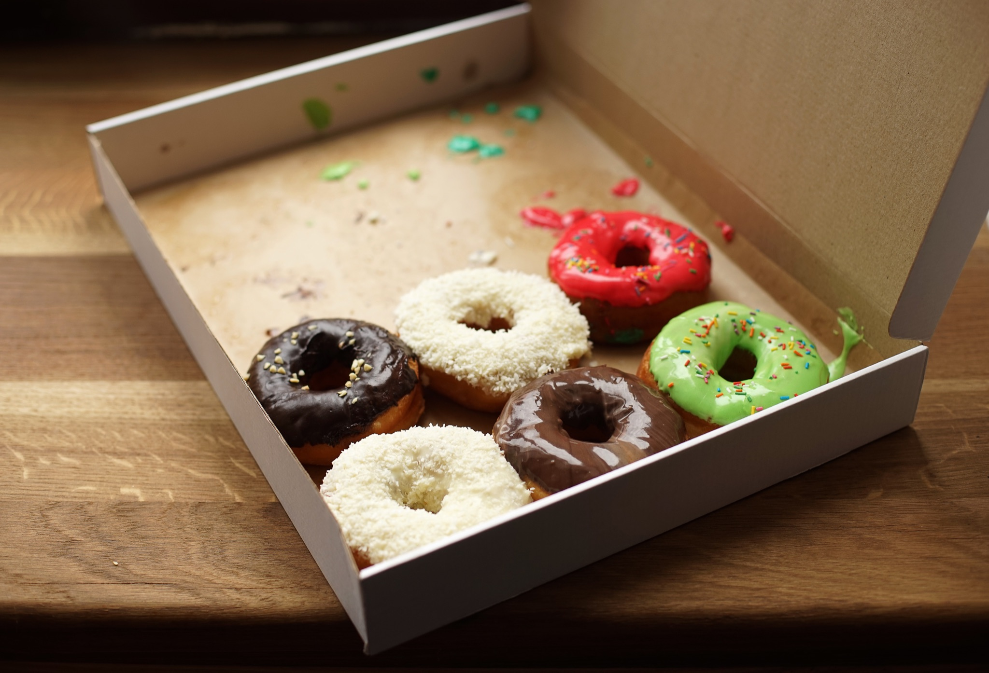
Here’s the model, what the story?

Slide 29
12 - 6 = 6

Slide 30
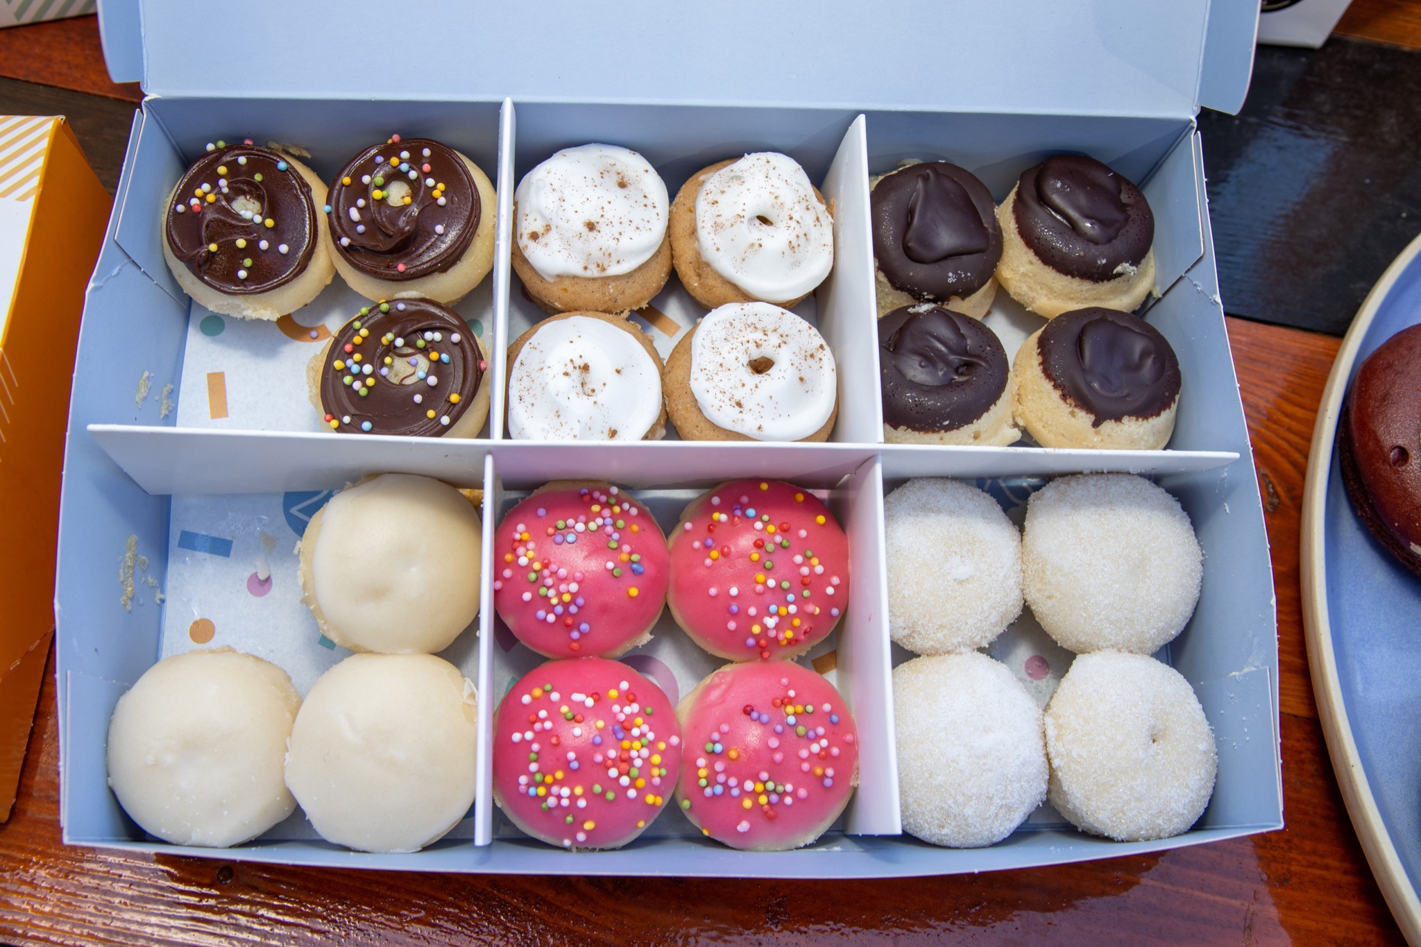
Here’s the model, what the story?

Slide 31
24 - 2 = 22

